Slide 1

HOSPITAL MANAGEMENT SYSTEM
MASTER OF COMPUTER APPICATIONS
Presentation by
(Kashish Gupta )
(17EGJCS072)
Mr. Giriraj Khandelwal Mr. Sachin Yadav
(Head of Department) (Training Incharge)
Global Institute Of Technology(GIT), JAIPUR
Affiliated to
Rajasthan Technical University, Kota
BTECH- (2017-2021)

Slide 2
INTRODUCTION
The Hospital Management System (HMS) is designed for Any Hospital to replace their existing manual, paper based system. This System targets to provide complete solution for Hospital and Health care services. This System can be used in any Hospital, Clinic, Diagnostics or Pathology labs for maintaining patient details and their test results. It Integrates the entire Resources of a Hospital into One Integrated Software Application.

Slide 3
PURPOSE
It helps you to minimize your repeated works and take care of the complete functionality of your hospital.
Minimize hand written work from admission to Discharge of patient and Final Billing
It is huge time saver and really facilitates proper communication among the management, staff and the patient parties.
Daily collection report.

Slide 4
System Specifications

Slide 5
Hardware Specifications

Slide 6
Processor
(Intel(R) core2 duo or above
RAM
1 GB or above
Hard Disk
100 GB

Slide 7
Software Specifications

Slide 8
Browser
Microsoft IE, Edge
Database
SQLITE3
Language
Python
Google Chrome
Mozilla Firefox
HTML, CSS
Platform
Operating System
Python
Windows 7 or above
flask

Slide 9
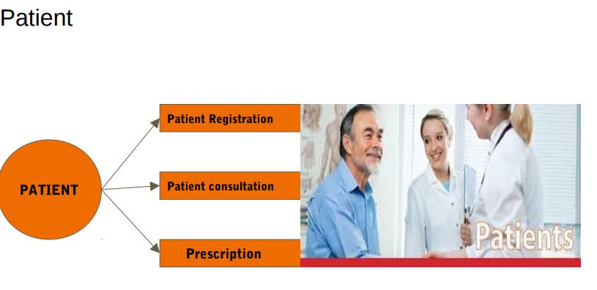

Slide 10
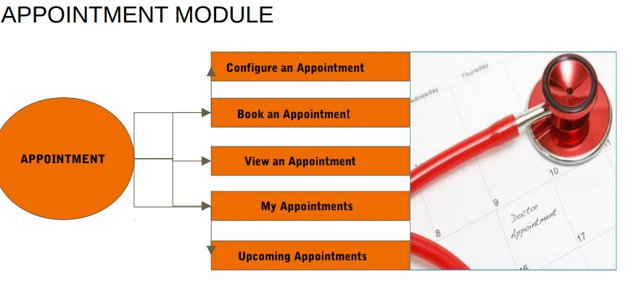

Slide 11
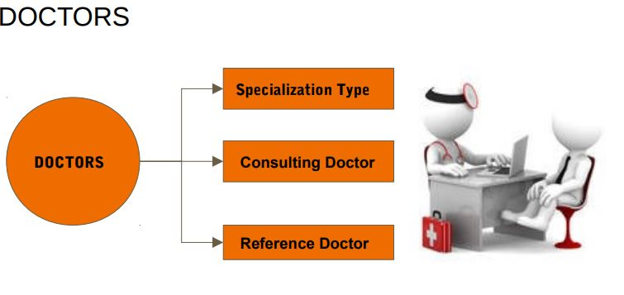

Slide 12
Screens Shots
👪

Slide 13
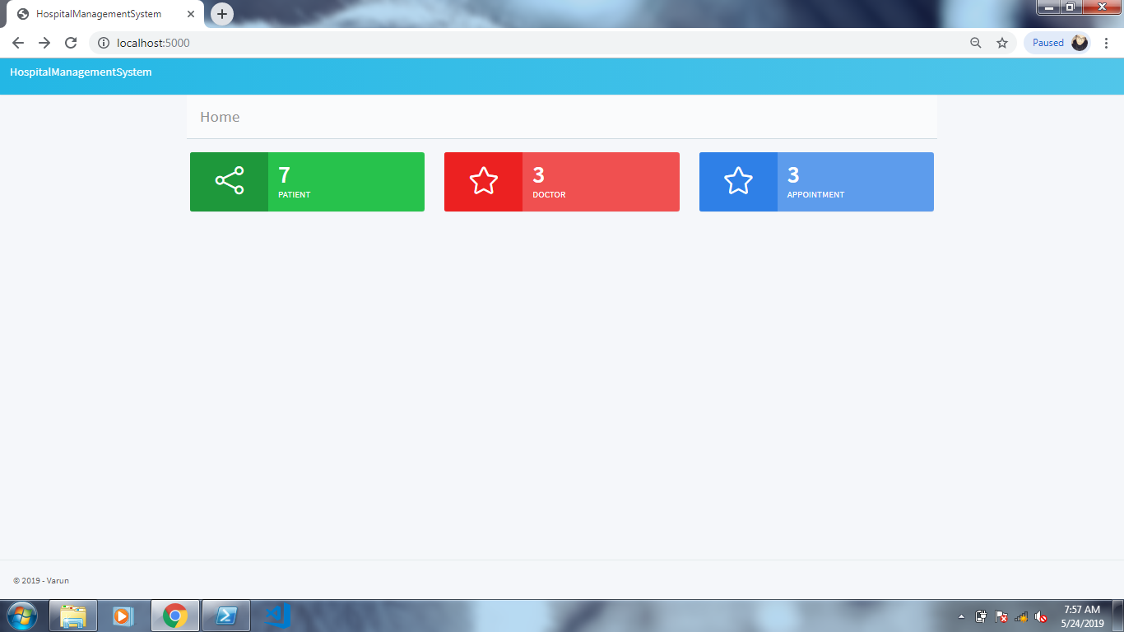
HOME PAGE

Slide 14
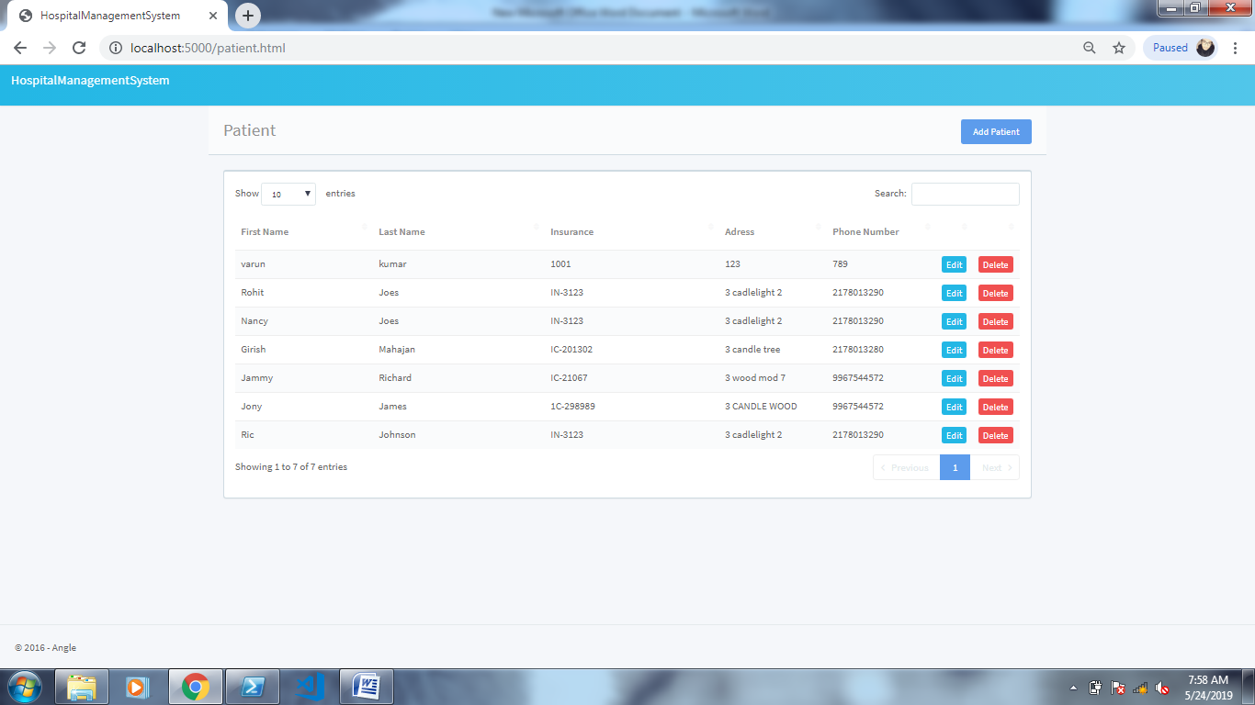
Patient Details

Slide 15
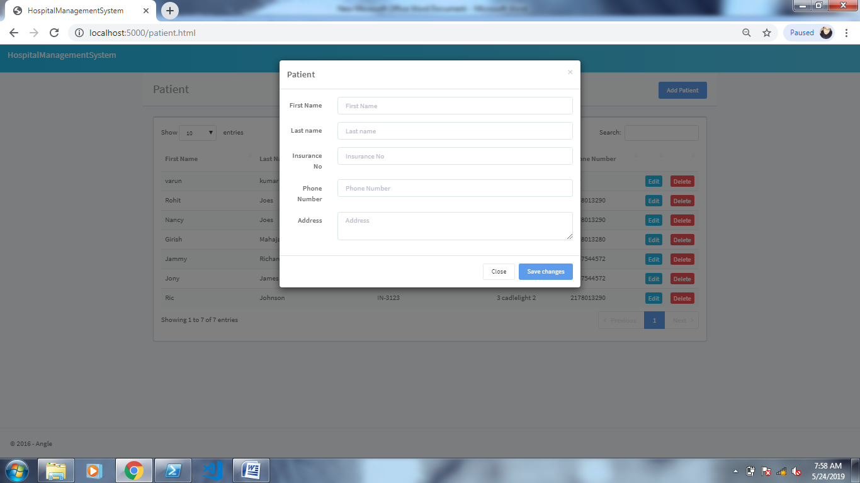
New Patient Deatils

Slide 16
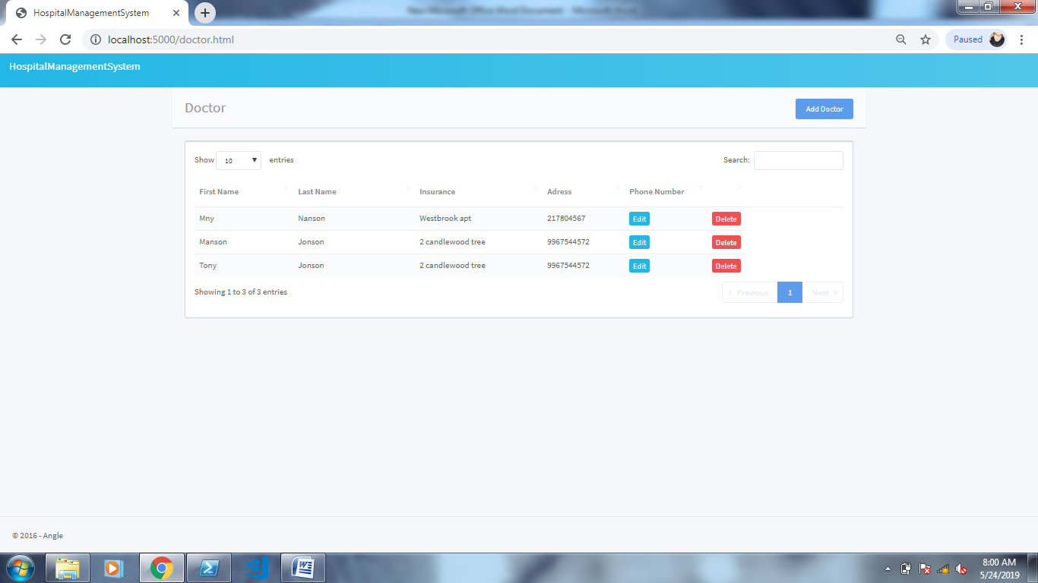
Doctor Details

Slide 17
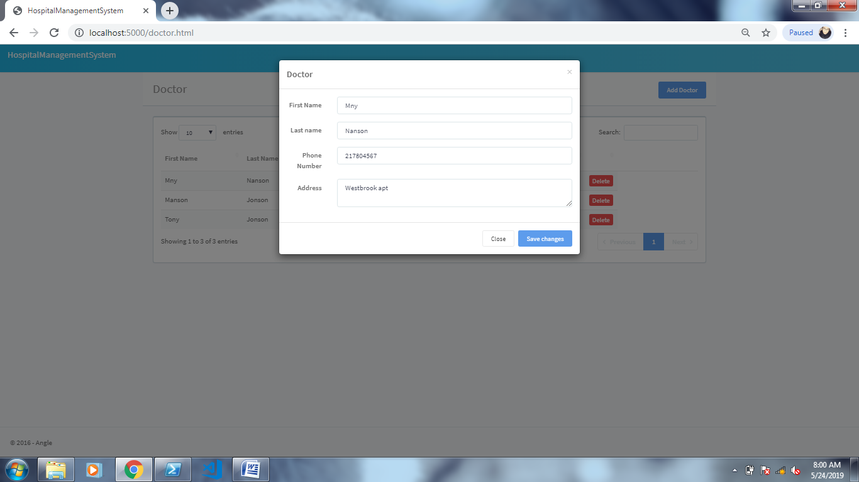
New Doctor Details

Slide 18
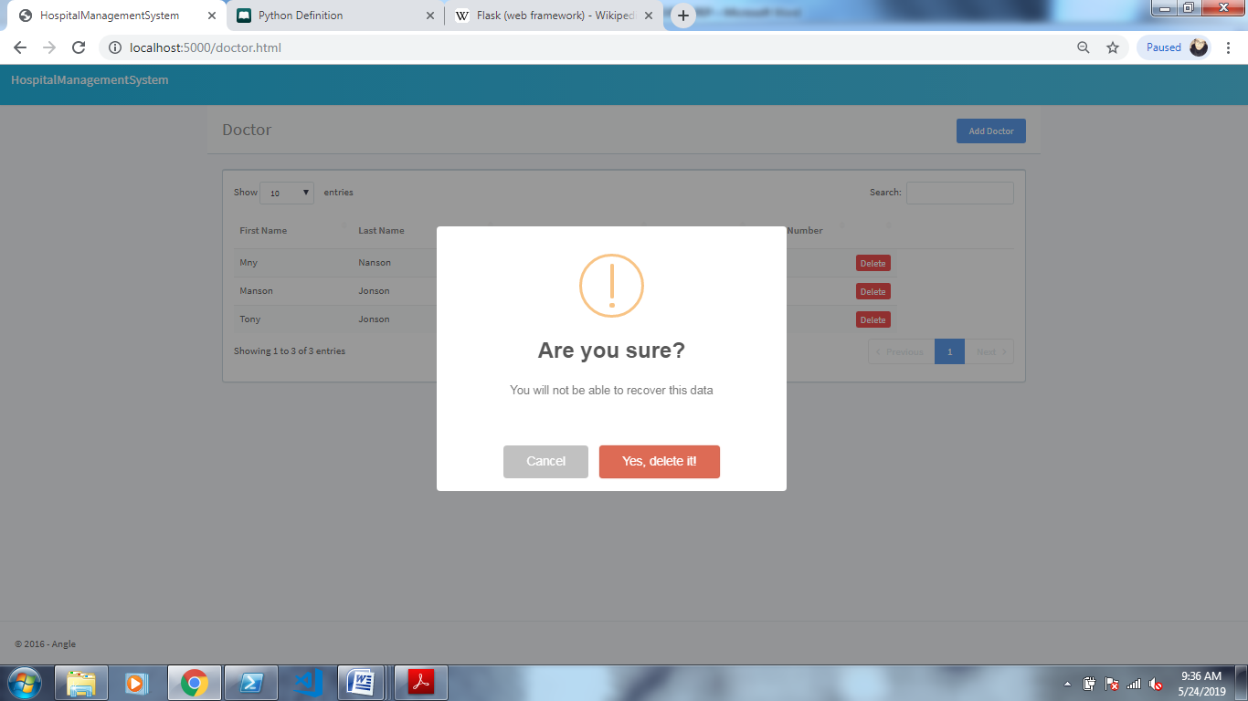
Remove Doctor

Slide 19
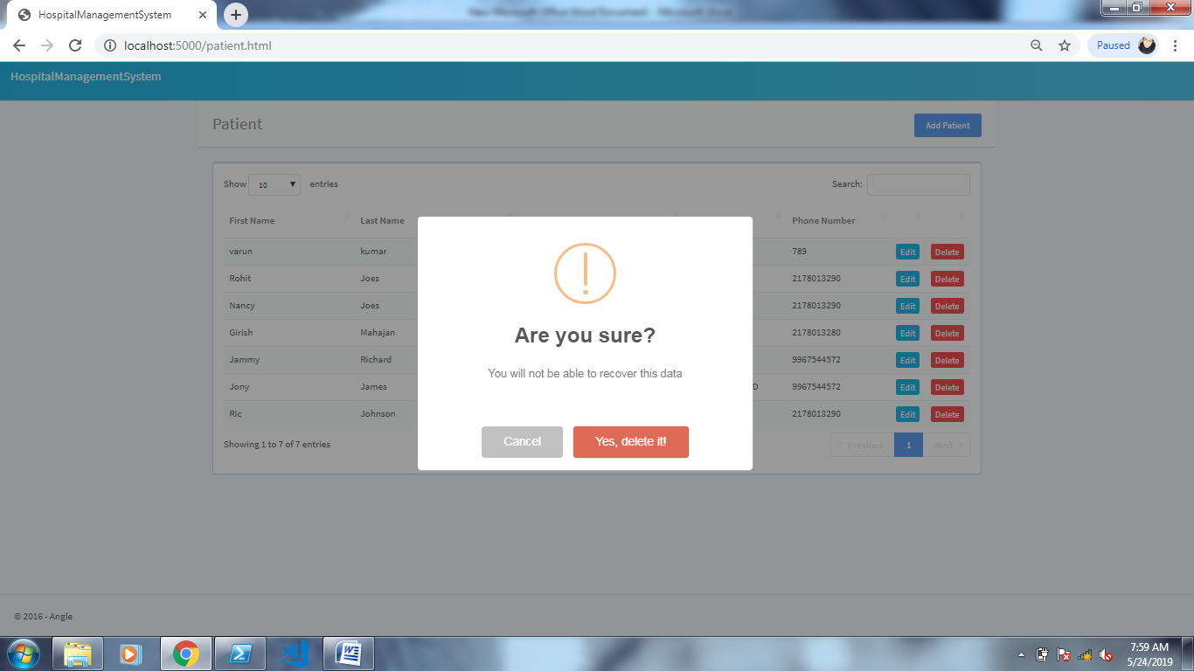
Delete Patient

Slide 20
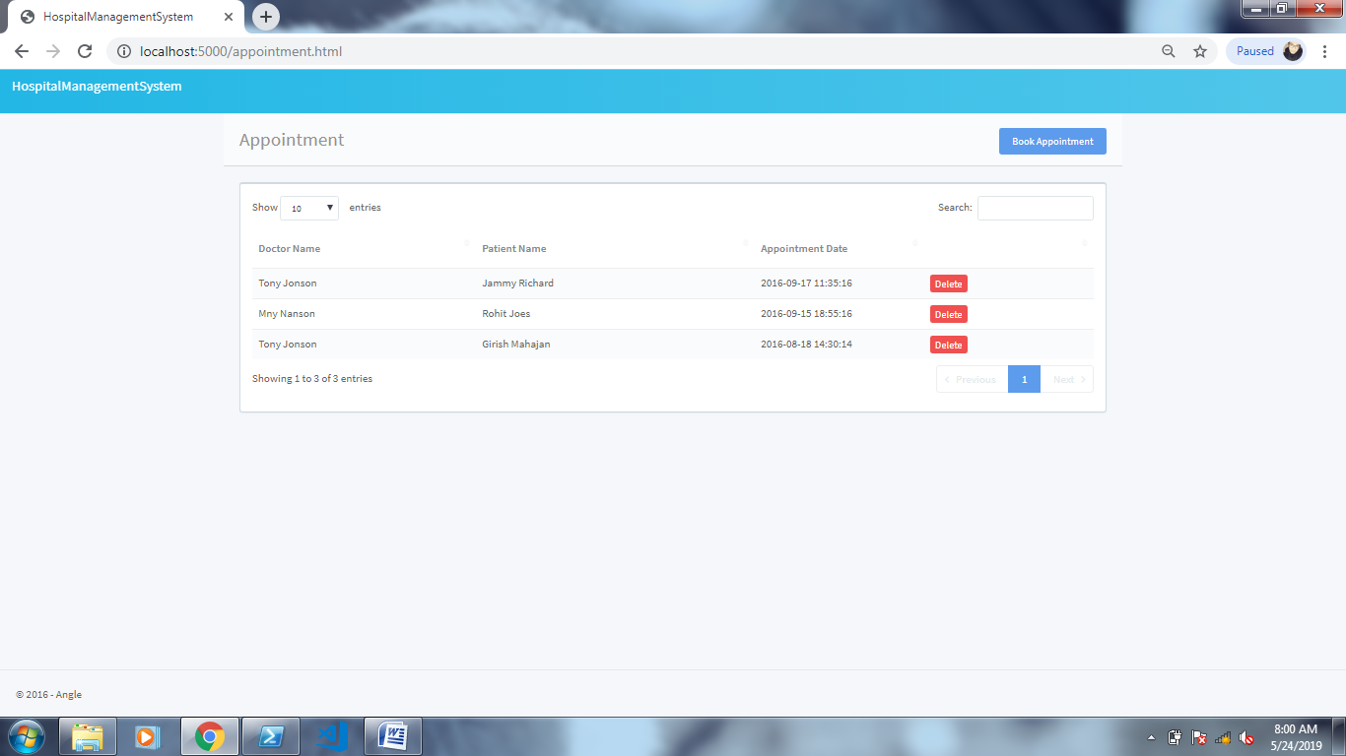
Appointment Details

Slide 21
Thank You

